Slide 1
Quantum-Inspired Genetic Algorithm
with Two Supportive Search Schemes (TSSS) and Artificial Entanglement (AE)
Chee Ken Choy (Kenny) Intelligent Computer Entertainment [ICE] Lab

Slide 2
History of Quantum-inspired Algorithms
The idea of first Quantum-inspired Genetic Algorithm (QiGA) was introduced in 1996 by Narayanan, A. [1] where he theorized, tested, and concluded that it outperforms classical GA (CGA)
Consequently, Han & Kim [2] proposed the first Quantum-inspired Evolutionary Algorithm (QEA) with newly defined representation term called “Q-bit” (formerly qubit) followed by improvements in [3-4]
[1] Narayanan, A., Mark M., "Quantum-inspired genetic algorithms." Evolutionary Computation, 1996, Proceedings of IEEE International Conference on. IEEE, 1996.
[2] Han, K.H., Kim, J.H., “Quantum-inspired Evolutionary Algorithm for a Class of Combinatorial Optimization,” IEEE Transactions on Evolutionary Computation, Piscataway, NJ: IEEE Press, vol. 6, no. 6, pp. 580-593, Dec. 2002.
[3] Han, K.H., Kim, J.H., “Quantum-inspired Evolutionary Algorithms with a New Termination Criterion, H_{ε} Gate, and Two-Phase Scheme,” IEEE Transactions on Evolutionary Computation, Piscataway, NJ:IEEE Press, vol. 8, no. 2, pp. 156-169, Apr. 2004.
[4] Han, K.H., Kim, J.H., "On the analysis of the quantum-inspired evolutionary algorithm with a single individual." Evolutionary Computation, 2006. CEC 2006. IEEE Congress on. IEEE, 2006.

Slide 3
The Basis of This Work
This work is an enhancement to Talbi, H. [5], introducing two novel approaches:
“Two Supportive Search Schemes” (TSSS), and
“Artificial Entanglement” (AE).
Talbi, H. [5] proposes a base implementation of QiGA with re-introduced GA operators, “Quantum Crossover” and “Quantum Mutation” while its representation is based on Han & Kim’s QEA (2002) “Q-bit”
[5] Talbi, H., Amer D., and Mohamed B., "A new quantum-inspired genetic algorithm for solving the travelling salesman problem." Industrial Technology, 2004. IEEE ICIT'04. 2004 IEEE International Conference on. Vol. 3. IEEE, 2004

Slide 4
The Basis of This Work
Timeline of significant Quantum-inspired advancement
1996
2002
2004
2006
QiGA [1]
QEA [3]
QEA [4]
QiGA [2]
QEA [5]
QiGA
[1] Narayanan, A., Mark M., "Quantum-inspired genetic algorithms." Evolutionary Computation, 1996.
[2] Talbi, H., Amer D., and Mohamed B., "A new quantum-inspired genetic algorithm for solving the travelling salesman problem." 2004
[3] “Quantum-inspired Evolutionary Algorithm for a Class of Combinatorial Optimization,” 2002.
[4] “Quantum-inspired Evolutionary Algorithms with a New Termination Criterion, H_{ε} Gate, and Two-Phase Scheme,” 2004.
[5] "On the analysis of the quantum-inspired evolutionary algorithm with a single individual.“ 2006.
QEA - Han, K.H. & Kim, J.H.

Slide 5
Understanding the Differences (Representation)
Quantum-inspired algorithms variant | GA
Smallest unit of information are referred to as “Q-bit” [2] where α and β are complex numbers that must satisfy |α|² + |β|² = 1. Represents multiple solutions at a same time for each chromosome, “Superposition”. | Binary bits [ 1, 0, 1, 1, 0, 1, 1, 0] Represents only 1 solution for each chromosome
|α|² → |0⟩ |β|² → |1⟩
[2] Han, K.H., Kim, J.H., “Quantum-inspired Evolutionary Algorithm for a Class of Combinatorial Optimization,” IEEE Transactions on Evolutionary Computation, Piscataway, NJ: IEEE Press, vol. 6, no. 6, pp. 580-593, Dec. 2002.

Slide 6
Understanding the Differences (Representation)
Quantum-inspired algorithms variant
0.0369 -0.9993 | 0.1162 -0.9932 | -0.2699 0.9629 | -0.7505 0.6609
“Measurement” phase
|α|² + |β|² = 1
Loop bit by bit
If (random[0.0-0.99] ≤ |β|²)
binaryStr += “1”
Else
binaryStr += “0”
= “1001”
= “0110”
= “1110”
…
Induces “parallelism”
Very small population

Slide 7
Understanding the Differences (Operators)
QiGA | GA
*Blue = belongs to Quantum-inspired algorithms in general *Black = specific to QiGA only (introduced by Talbi, H. [5]) Operators Quantum Interference / Rotation, Quantum Crossover, Quantum Mutation, Quantum Shift, Measurement | Crossover, Mutation
[5] Talbi, H., Amer D., and Mohamed B., "A new quantum-inspired genetic algorithm for solving the travelling salesman problem." Industrial Technology, 2004. IEEE ICIT'04. 2004 IEEE International Conference on. Vol. 3. IEEE, 2004

Slide 8
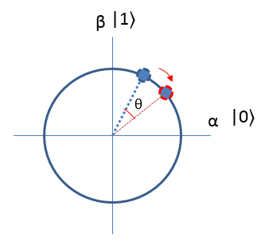
Quantum Interference /Rotation Example
0.631
0.776
Every Q-bits are rotated based on Q-bit of the best solution kept at the same bit position
In every iteration, individuals in the population are “guided” by the best solution at a certain degree depending on the angle, θ set.
Bit size
1 | 0 | 1 | 1
1 | 0 | 0 | 1
1 | 1 | 0 | 1
1 | 0 | 1 | 1
Sample set of best solution
observed
Dimension, N = 4

Slide 9
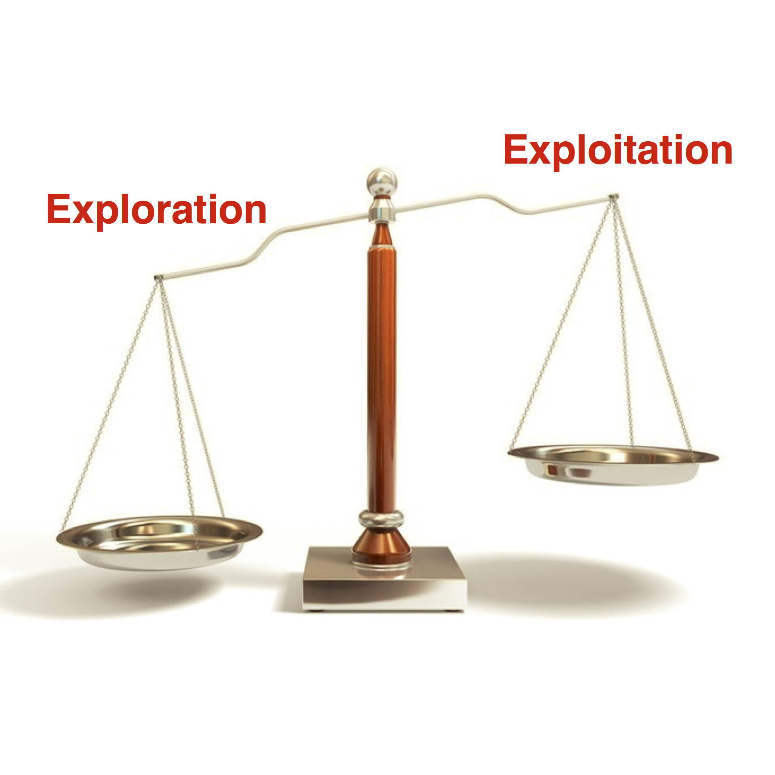
Heuristic Search Fundamental Problems
Premature convergence
Exploration and Exploitation Dilemma
Edelkamp et al. argued that a policy to ensure convergence is difficult to formulate
[6] Edelkamp, S., Stefan S., “Heuristic search: theory and applications.” Pg. 542. Elsevier, 2011.

Slide 10
Proposed Methods (1)
Two Supportive Search Schemes (TSSS)
Local Best Solution (LBS) refers to best solution of current iteration
Global Best Solution (GBS) refers to best solution so far
 | “Explore” | “Exploit”
Purpose | To identify a potential optima | To “dive” into the identified optima
Angle, θ | π / 9 | π / 180
Interference based on | Local Best Solution | Global Best Solution
Shift Rate | 0.5 | 0.2
π here means 180˚

Slide 11
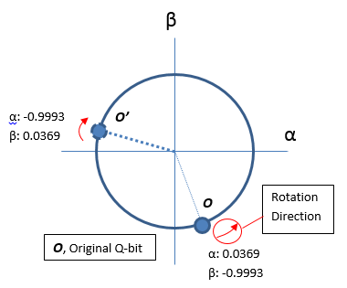
Proposed Methods (2)
Artificial Entanglement (AE)
Conforms to two core principles of Quantum Entanglement
Correlated values
Rotational behavior
Begin by creating artificially entangled population(s) where:
Each Q-bits are “entangled” in the same position as in the quantum genes
α: 0.9993
β: -0.0369
Correlated but not the same values, and must be reversible
Entangled qubits are always found to be rotating in the opposite direction
O’’

Slide 12
Proposed Methods (2)
Observed results better than GBS?
If yes, then with P_{swap} ,
replace the original
Entangled
Original
0.0369 -0.9993 | 0.1162 0.9932 | -0.2699 0.9629 | -0.7505 -0.6609

Slide 13
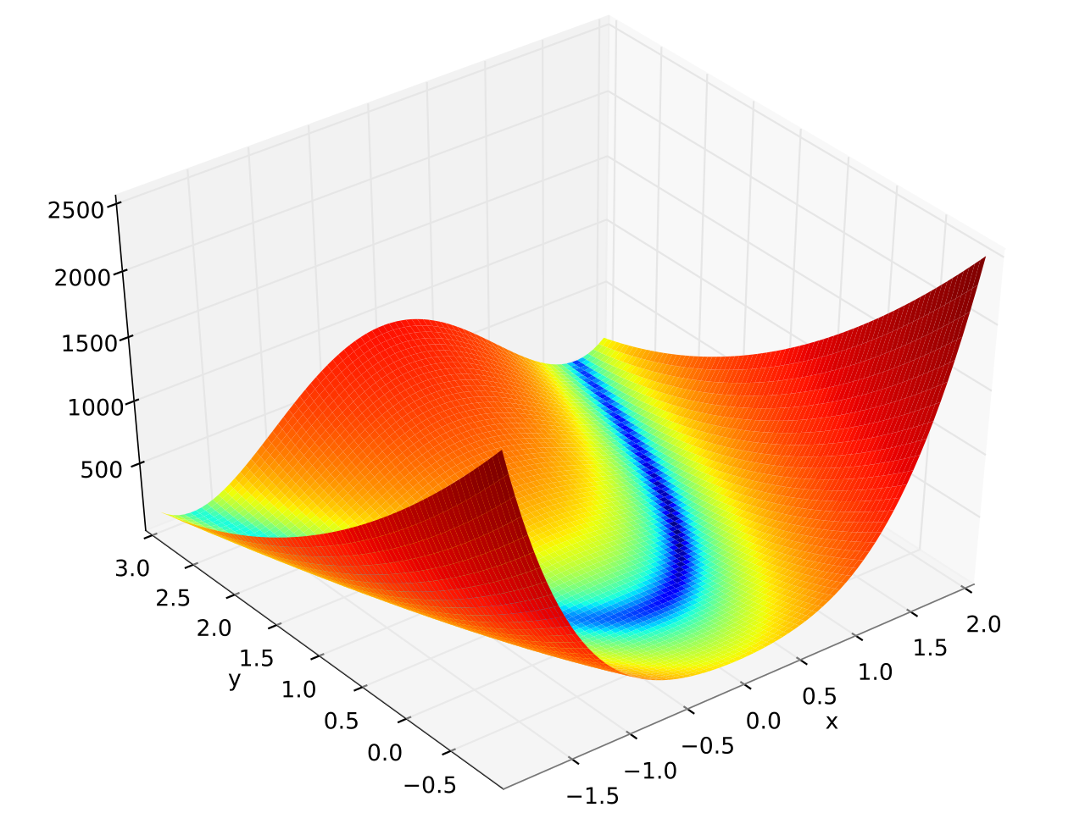
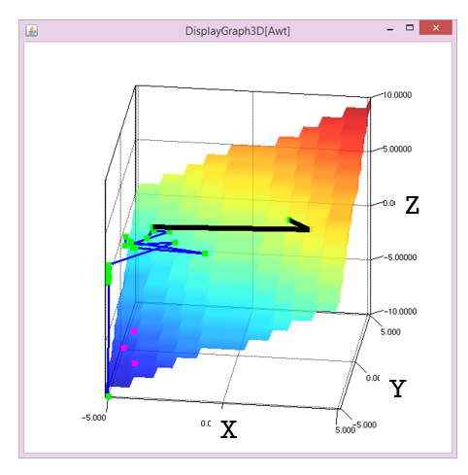
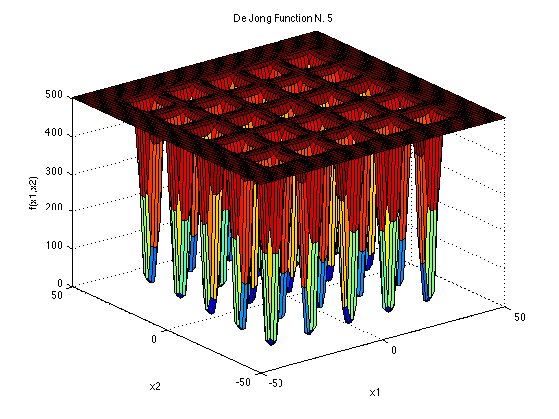
Experiment Setup (Numerical Optimization Functions)
Domain variables:
Bit size: 25
Dimension, N:
30 for Rosenbrock, Step
2 for Shekel
Termination Condition:
Value-To-Reach (VTR)
Rosenbrock, min f = 0.0
Step, min f = -150
Rosenbrock, f < 1e-6
Step, f = -150.0
Shekel, f < 0.9986
*Value refers to Fitness, f
Shekel, min f = 0.998
[7] Storn, R., and Kenneth P.. "Differential evolution–a simple and efficient heuristic for global optimization over continuous spaces." Journal of global optimization 11.4 (1997): 341-359, 1997

Slide 14
eQiGA Experiment Setup (Algorithm Parameters)
General parameters:
Population Size : 2
Quantum Crossover : 70%
Quantum Mutation : 30%
Quantum Mutation Threshold : 5%
Quantum Shift : Based on TSSS
Rotation Angle, θ : Based on TSSS
# of measure : 1
 | “Explore” | “Exploit”
Purpose | To identify a potential optima | To “dive” into the identified optima
Angle, θ | 20˚ | 1˚
Interference based on | Local Best Solution | Global Best Solution
Shift Rate | 50% | 20%
AE parameters:
Number of entangled population : 3
Probability, P to measure entangled : 1%
P_{swap} to swap entangled : 50%

Slide 15
Numerical Optimization Results
 |  | m. | σ | r. | m. ending fitness
f _{Rosenbrock} N = 30 | eQiGA | 16637.2 | 12161.2 | 100/100 | 4.2E-07
 | QEA | - | - | 0/100 | 1.894
f _{Step} N = 30 | eQiGA | 2240.1 | 1749.5 | 100/100 | -150
 | QEA | 61413.6 | 54865.0 | 100/100 | -150
f _{Shekel} N = 2 | eQiGA | 2564.5 | 1719.0 | 100/100 | 0.9983
 | QEA | 5944.5 | 10511.5 | 100/100 | 0.9982
Values are referred as “Search Cost” which is number of times that the functions are called. m. = mean of FEs (Function Evaluations) σ = standard deviation r. = success rate in converging within fixed number of trials
Reported results are of the best set of results obtained from both comparing sources.
Maximum search cost is set to 2,000,000. Trials that exceeds the max search cost are deemed failed cases.

Slide 16
Conclusion
As a similar variant of FEP, eQiGA is effective even in a high-dimensional difficult problem (Rosenbrock function)
AE holds a good potential because it has a high degree of freedom
Correlation policy and,
Rotational behavior;
Results have proven that the proposed algorithm is superior to QEA
Future works include reduction of parameters and towards “expensive” problems that represents real-world variables such as CEC2014
*FEP = Fast Evolutionary Programming

Slide 17
Thank you
Any questions are certainly most welcomed.

Slide 18
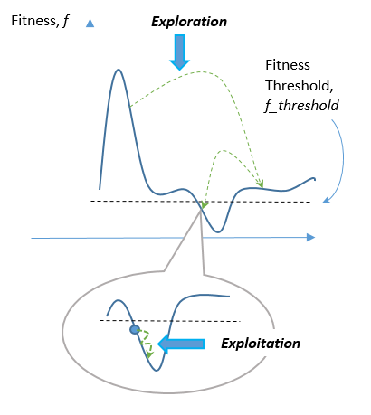
Fitness-threshold (FT)
As an assistive strategy to TSSS, this serves as a bridge between exploration and exploitation
Only works if target objective is known.
Based on defined FT, scheme switch occurs immediately if current best fitness falls under the threshold.

Slide 19
Fitness-threshold (FT)
Fitness Threshold:
(Problem-dependent)
Rosenbrock : 2.0
Step : -135.0
Shekel : 1.5

Slide 20
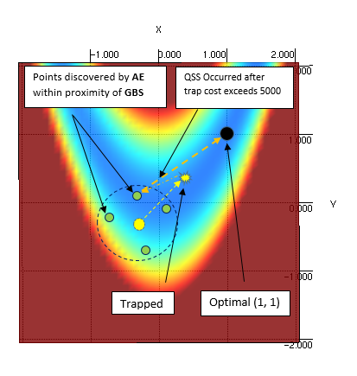
Quantum side-stepping (QSS)
On contrary to backtracking, this is called “Sidestepping”
Sidesteps to a point discovered by AE
Tests have shown QSS is effective as it converges very quickly into the global optimum after escaping from a trap.

Slide 21
Quantum side-stepping (QSS)
Quantum Side-Stepping (QSS) parameters:
Sidestep Threshold : 25.0
Trapped Cost Threshold : 5000

Slide 22
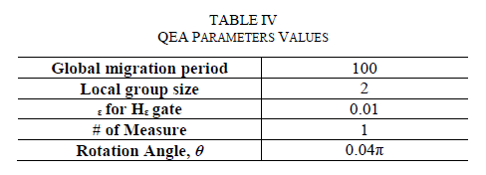
QEA Parameters

Slide 23
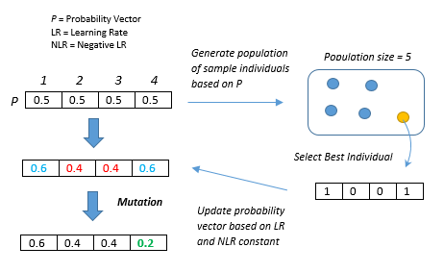
Estimation of Distribution Algorithm (EDA)
Quantum-inspired algorithms can be considered as a part of EDA
Population-Based Incremental Learning (PBIL)

